Slide 1

ENGINEERING CHEMISTRY
Asha A
Department of Science and Humanities

Slide 2

ENGINEERING CHEMISTRY
Module 7- Functional materials-Polymers
Class content:
Structure –property relationship
Crystallinity
Tensile strength
Elasticity
Chemical resistance
Plastic deformation

Slide 3
ENGINEERING CHEMISTRY
Module 7- Functional materials-Polymers
Structure - property relationship of polymers
Polymers are extremely versatile when it comes to their properties
Some are hard while others are soft and flexible
Some are insoluble and resistant to heat while others are soluble and fusible
Properties of polymers are influenced by their structure

Slide 4
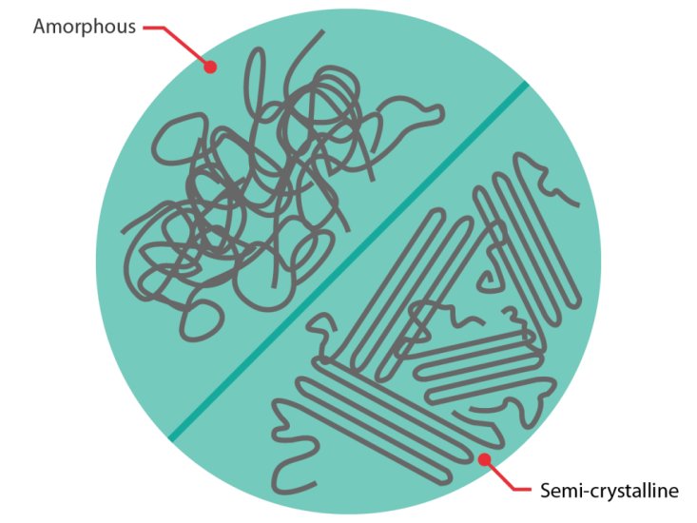
ENGINEERING CHEMISTRY
Module 7- Functional materials-Polymers
Crystallinity :
The degree of cystallinity of a polymer depends on its structure and configuration
Polymers contain both crystalline and amorphous regions
Crystalline regions occur when polymer chains are arranged in an orderly fashion parallel and close to each other
https://coventivecomposites.com/explainers/types-of-polymer-matrix/

Slide 5
ENGINEERING CHEMISTRY
Module 7- Functional materials-Polymers
Structure:
Polymers made up of linear chains without bulky pendant groups are more crystalline
e.g., Polyethylene(PE) is more crystalline then polyvinylacetate
Polymers containing polar groups are more crystalline
A close packing between polymeric chains because of strong secondary forces like dipole–dipole interactions or hydrogen bonding imparts a high degree of crystallinity
e.g., PVC is more crystalline than PE

Slide 6
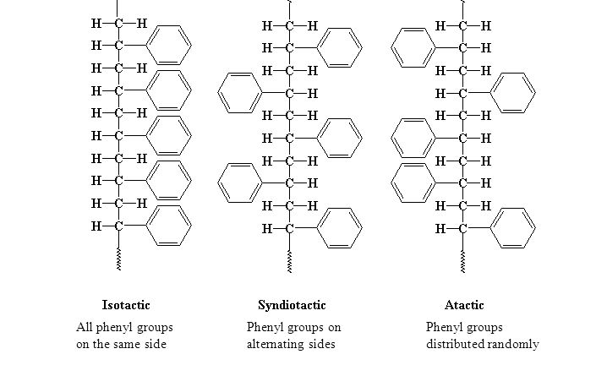
ENGINEERING CHEMISTRY
Module 7- Functional materials-Polymers
Configuration:
Crystallinity also depends on the stereoregularity of the polymer
Based on stereoregularity polymers are classified as isotactic, syndiotactic and atactic
Isotactic polymers are found to be most crystalline while atactic are found to be least crystalline
High crystallinity leads to sharper melting point, greater rigidity, strength and density
Source:https://slideplayer.com/slide/5759919/

Slide 7
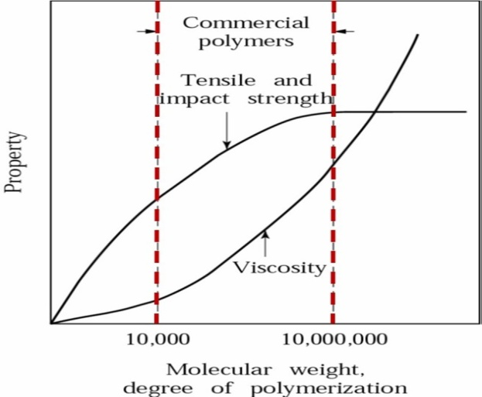
ENGINEERING CHEMISTRY
Module 7- Functional materials-Polymers
Tensile strength:
The amount of stress a polymer can take before undergoing permanent deformation
Tensile strength depends on :
Molecular mass - low molecular mass polymers are soft and
gummy, high molecular mass polymers are tough and heat
resistant
By increasing molecular mass the tensile strength increases to a certain extent and then becomes constant
Melt viscosity initially shows gradual increase then increases steeply with high molecular weight
Source:https://polymerinnovationblog.com/polymer-composites-part-2-introduction-polymer-resins/

Slide 8
ENGINEERING CHEMISTRY
Module 7- Functional materials-Polymers
Tensile strength increases when polymer has polar
groups
Force of attraction between chains prevents polymer
chains from slipping against each other
e.g., PVC, Nylon
Cross linking in a polymer also increases its tensile
strength

Slide 9
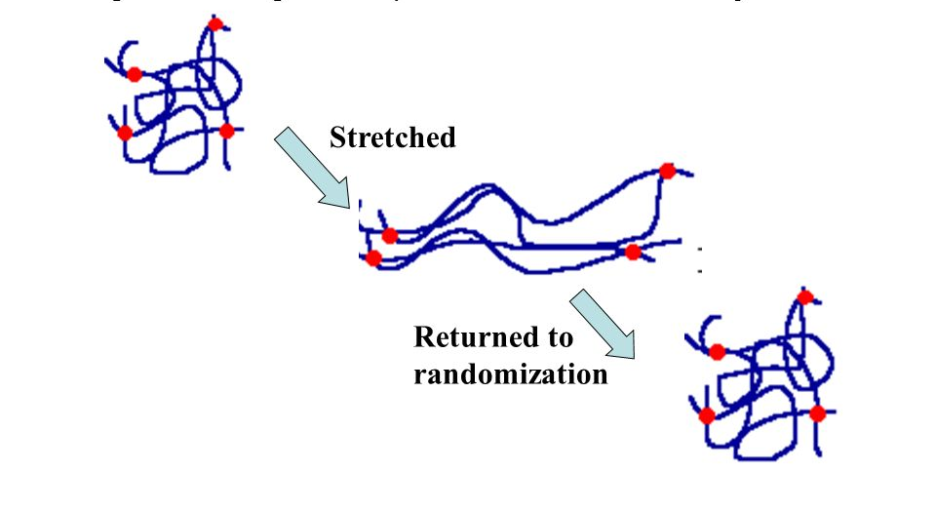
ENGINEERING CHEMISTRY
Module 7- Functional materials-Polymers
Elasticity :
The property of a polymer by which it deforms on applying force and regains original shape on release of force is called elasticity
Elastomers have long coiled and entangled chains which straighten and orient themselves on stretching. When stress is removed they go back to coiled form
For a polymer to show elasticity the individual chains should not break on prolonged stretching
Source:https://slideplayer.com/slide/8755303/

Slide 10
ENGINEERING CHEMISTRY
Module 7- Functional materials-Polymers
Presence of polar groups in the polymer chain results
in strong secondary force of attraction between the
chains making them stiff and inflexible
Non polar groups have weak van der Waal’s
attraction between them and hence they are more
elastic
Presence of bulky, aromatic and cyclic groups in the
polymer decreases the elasticity of the polymer

Slide 11
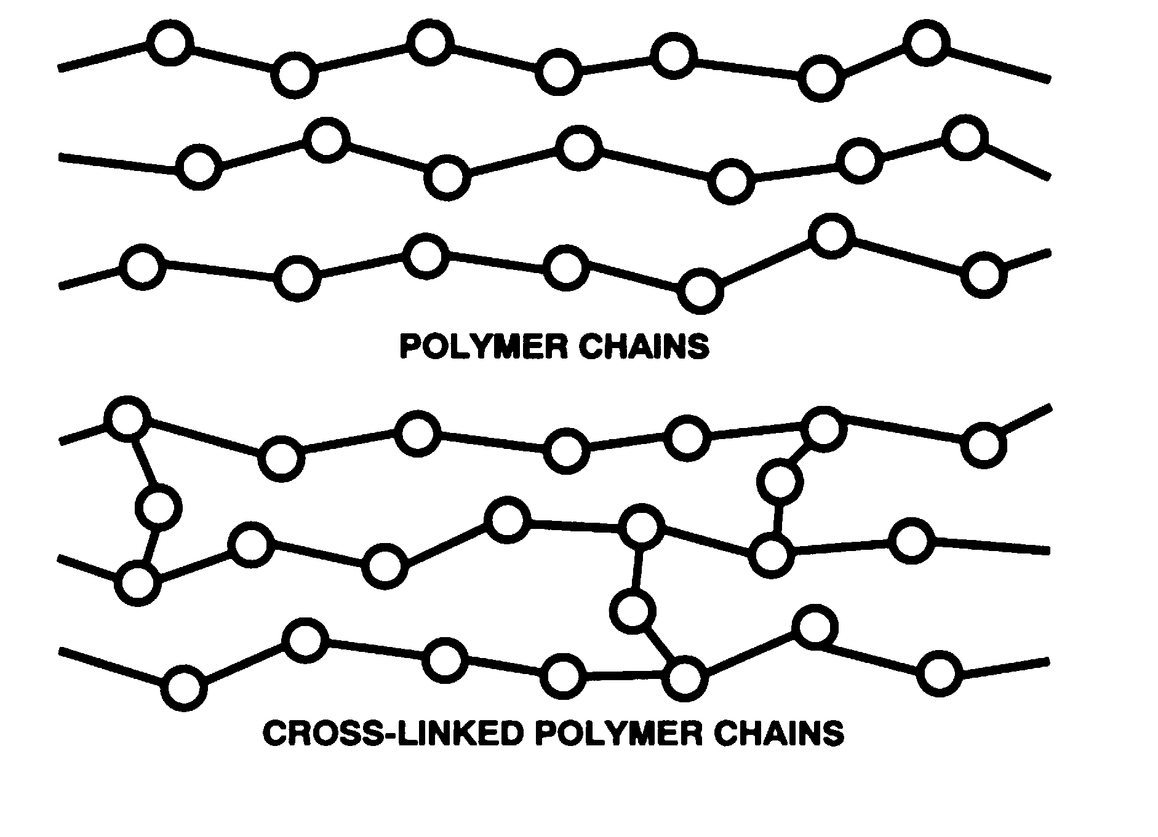
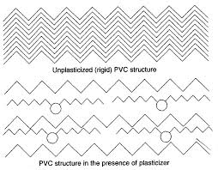
ENGINEERING CHEMISTRY
Module 7- Functional materials-Polymers
In elastic materials such as natural rubber, elasticity can be improved by introducing cross linking at suitable molecular positions like in vulcanisation
In non-elastic materials, elasticity is achieved by using plasticisers , for example (Ph₃PO₄), which enter between the polymer chains and make a hard polymer more flexible
Source:https://revision4gcses.wordpress.com/science/chemistry-2/polymers/
Source:https://www.diva-portal.org/smash/get/diva2:1312811/FULLTEXT01.pdf

Slide 12
ENGINEERING CHEMISTRY
Module 7- Functional materials-Polymers
Chemical resistance:
Resistance to swell, dissolve and get degraded in the presence of a solvent or chemical
It depends on the chemical nature of monomeric units and their molecular arrangement
Presence of polar and non-polar groups: Like dissolves like - A polymer is more soluble in a solvent of similar chemical structure
Polymers having polar groups (–OH or –COOH groups) are usually attacked or dissolved by polar liquids such as water or alcohols. (e.g. PVA dissolves in water)
Polymers with non-polar groups such as –CH₃ and –C₆H₅ are not easily attacked by polar solvents but they easily swell and sometimes dissolve in non-polar solvents such as petrol, benzene and carbon tetrachloride

Slide 13
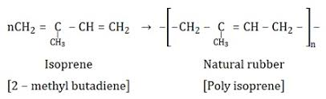

ENGINEERING CHEMISTRY
Module 7- Functional materials-Polymers
Residual unsaturation leads to oxidative degradation: polymers with residual double bonds get attacked and degraded in air and UV light
e.g.,natural rubber
Source:https://www.embibe.com/study/natural-rubber-vulcanization-of-natural-rubber-concept?entity_code=KTBP50
Packing: Dense packing does not allow the solvent to penetrate between the layers hence resistance increases, for example Teflon
Molecular mass: For a given polymer, the swelling character decreases with the increase in the molecular mass
Degree of cross linking: Greater the degree of cross linking lesser is the solubility
Source:https://pslc.ws/macrog/ptfe.htm

Slide 14
ENGINEERING CHEMISTRY
Module 7- Functional materials-Polymers
Plastic deformation :
Property of a polymer by which on application of heat it becomes soft and flexible and on cooling returns to its original shape is called plasticity or plastic deformation
Based on their response to heat two kinds of polymers are:
Thermoplastic - A thermoplastic polymer is one which softens on heating and becomes hard on cooling. It can be remoulded into new shapes, e.g., Polyethylene, polypropylene, polystyrene
Thermosetting - A thermosetting polymer becomes hard on heating. It cannot be remoulded, its structure instead undergoes a total degradation on heating, e.g.,Bakelite, Aniline aldehyde resin, urea formaldehyde resin

Slide 15
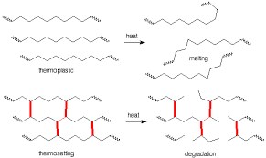
ENGINEERING CHEMISTRY
Module 7- Functional materials-Polymers
The reason for the difference in the thermal behaviour is:
Thermoplastics have relatively weak forces of attraction like van der Waals forces, dipole-dipole attraction or H-bonding between the chains, which are overcome when the material is heated
Thermosetting plastics have the cross-linking between the chains is by strong covalent bonds cannot be broken easily. On strong heating will result in charring and degradation
Source:http://chemistry2.csudh.edu/rpendarvis/Polymer.html

Slide 16
THANK YOU
Asha A
Department of Science and Humanities

